Slide 1
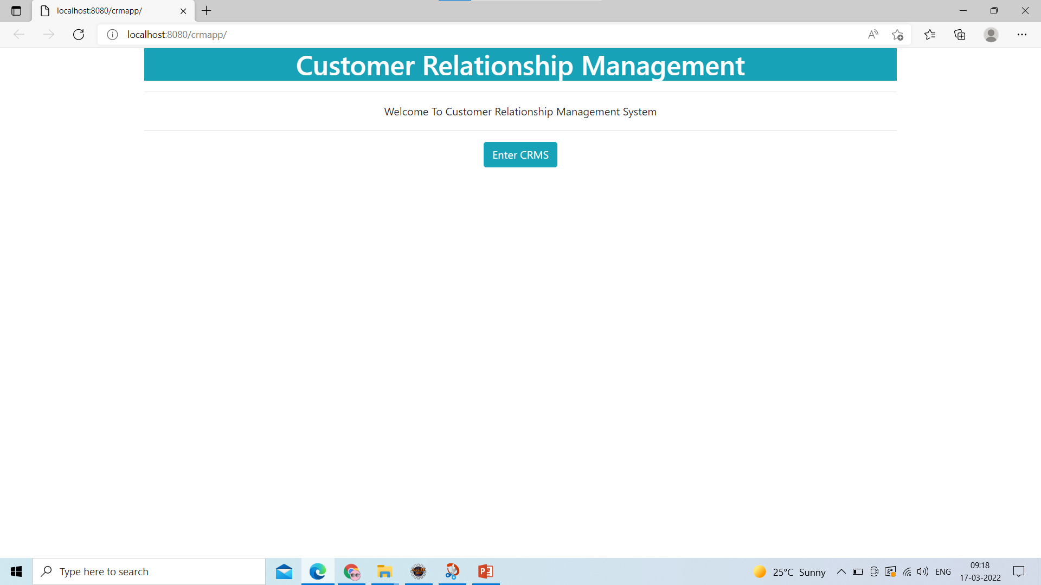
1) Welcome Page

Slide 2
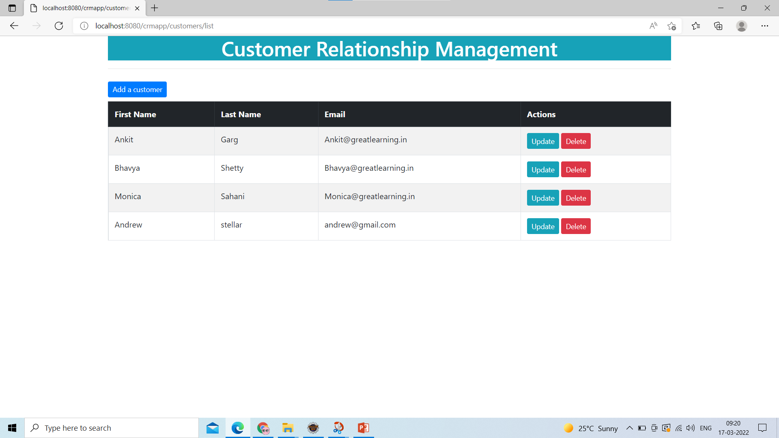
2)Home Page – Customer List

Slide 3
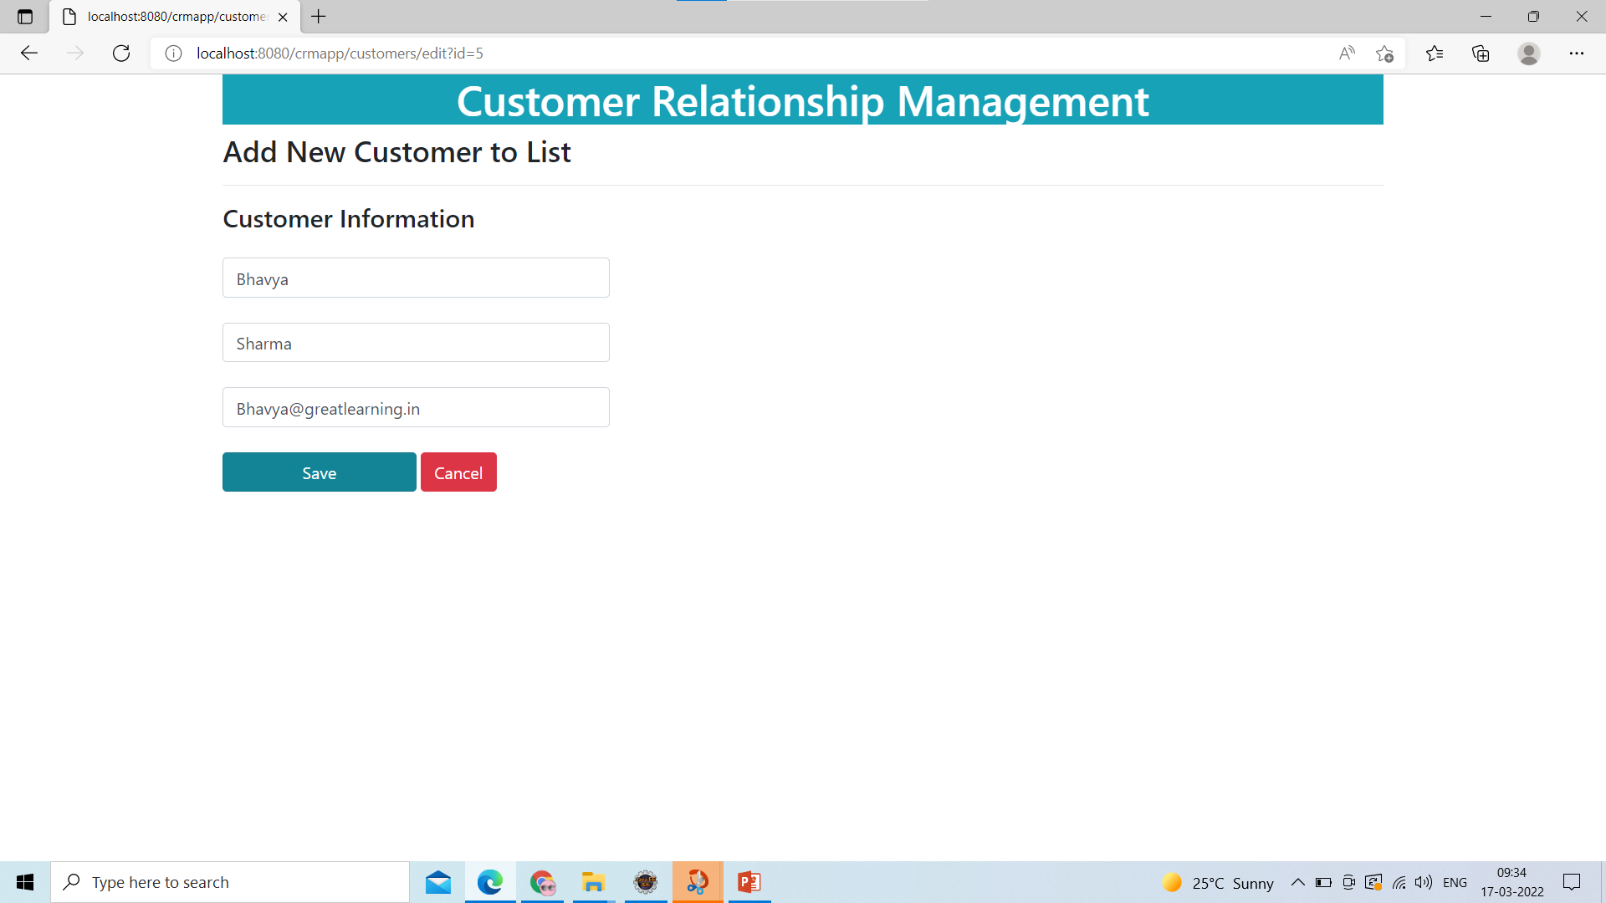
3) Update Customer Details

Slide 4

4) Updated Customer Details

Slide 5
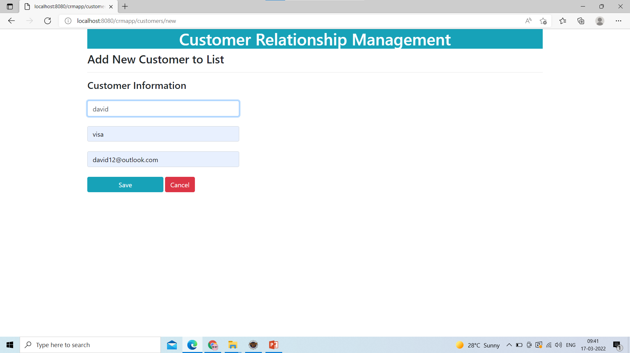
5) Add New Customer

Slide 6
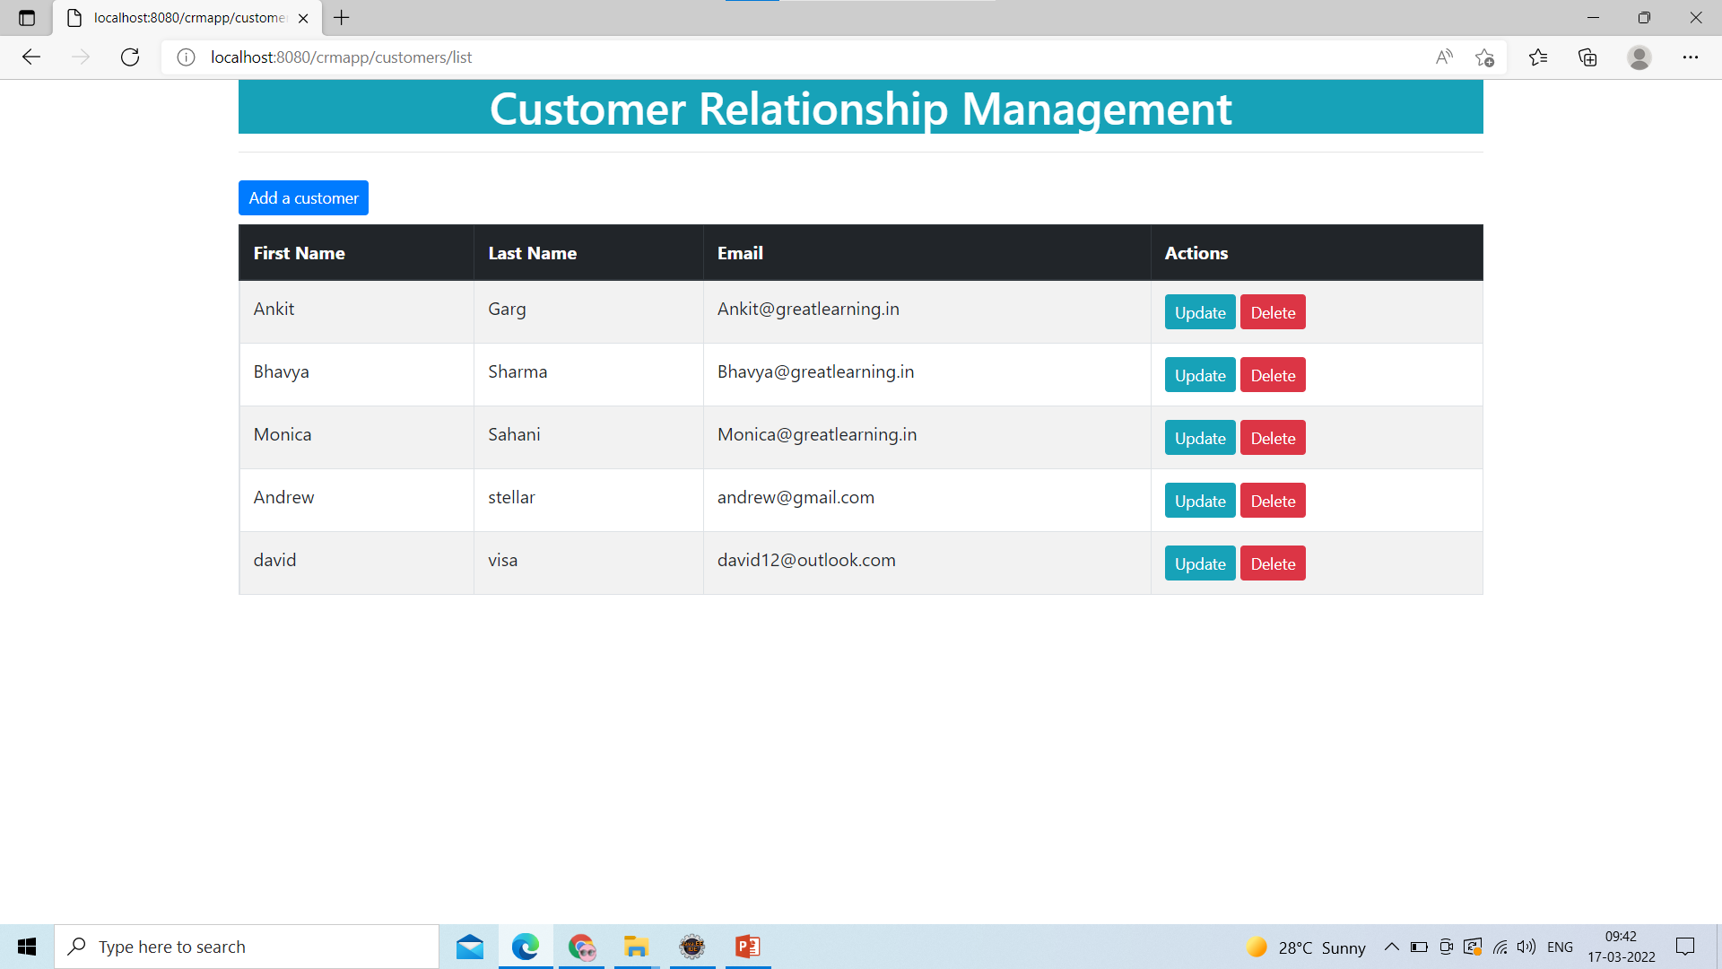
6)Added new to – Customer list

Slide 7
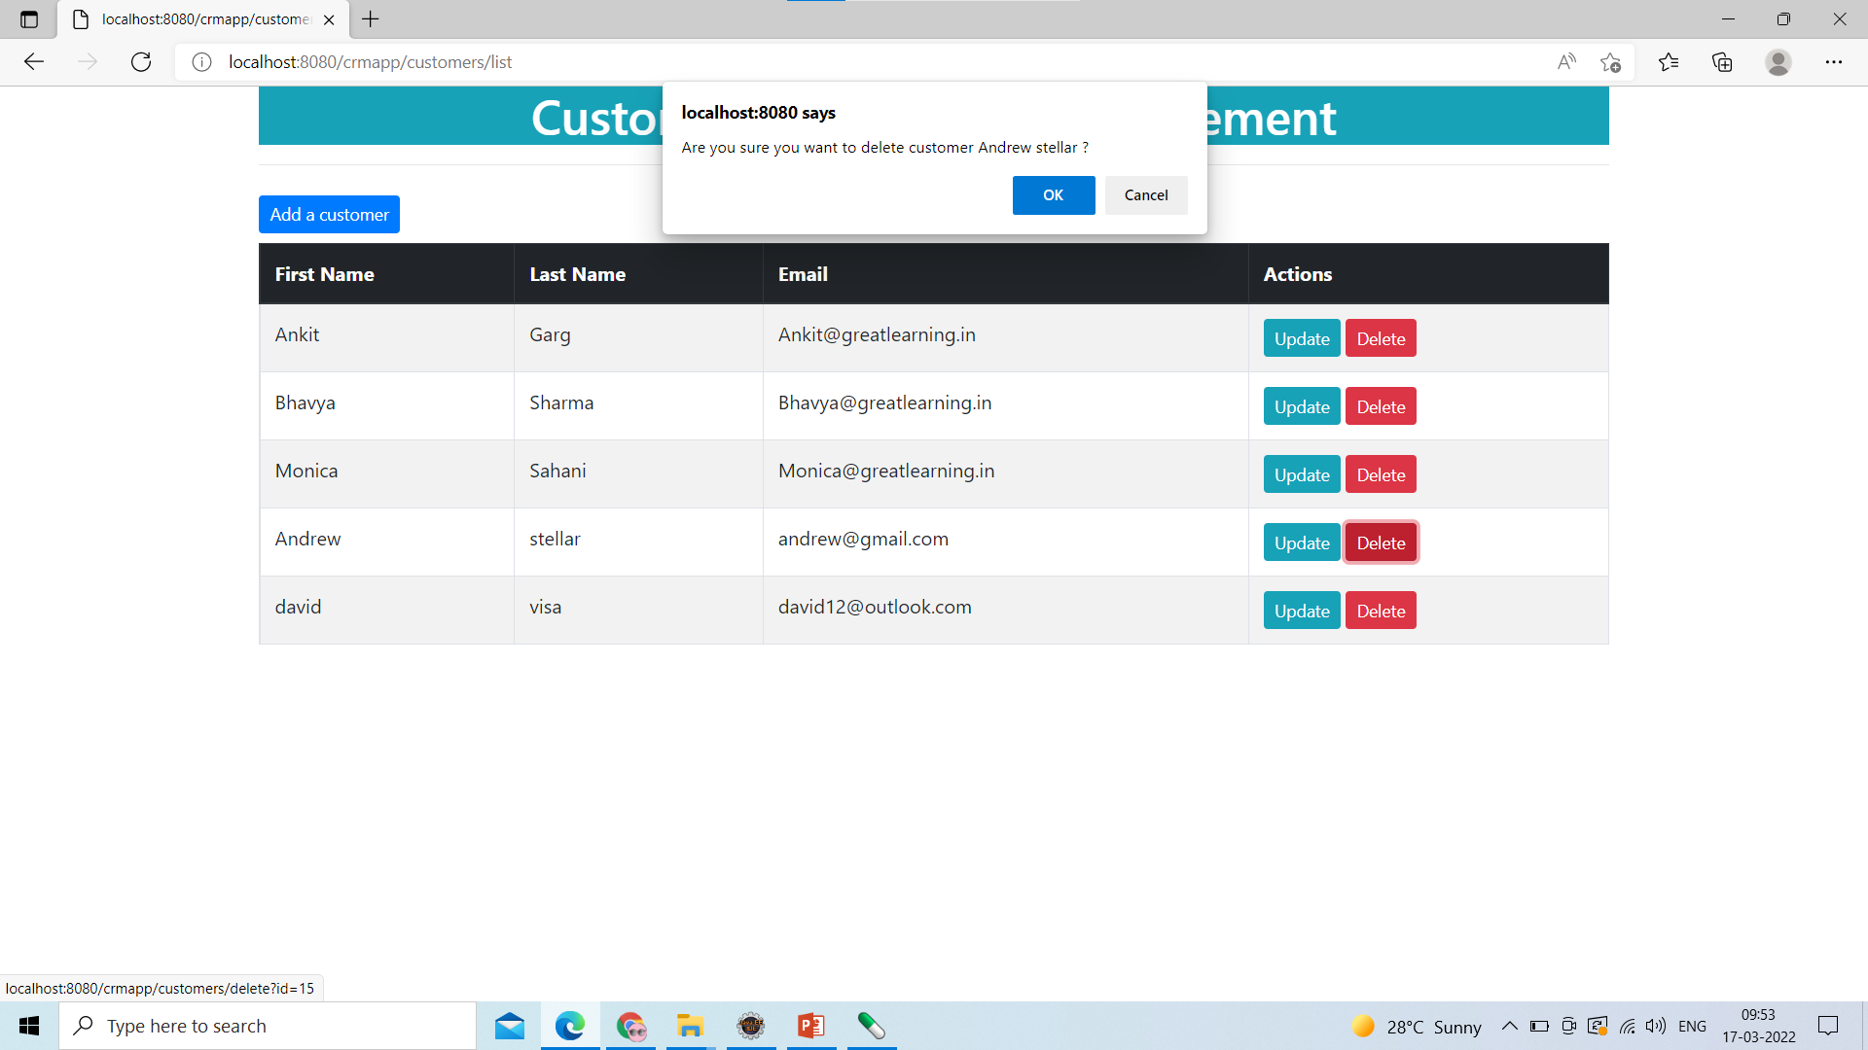
7) Delete Customer

Slide 8
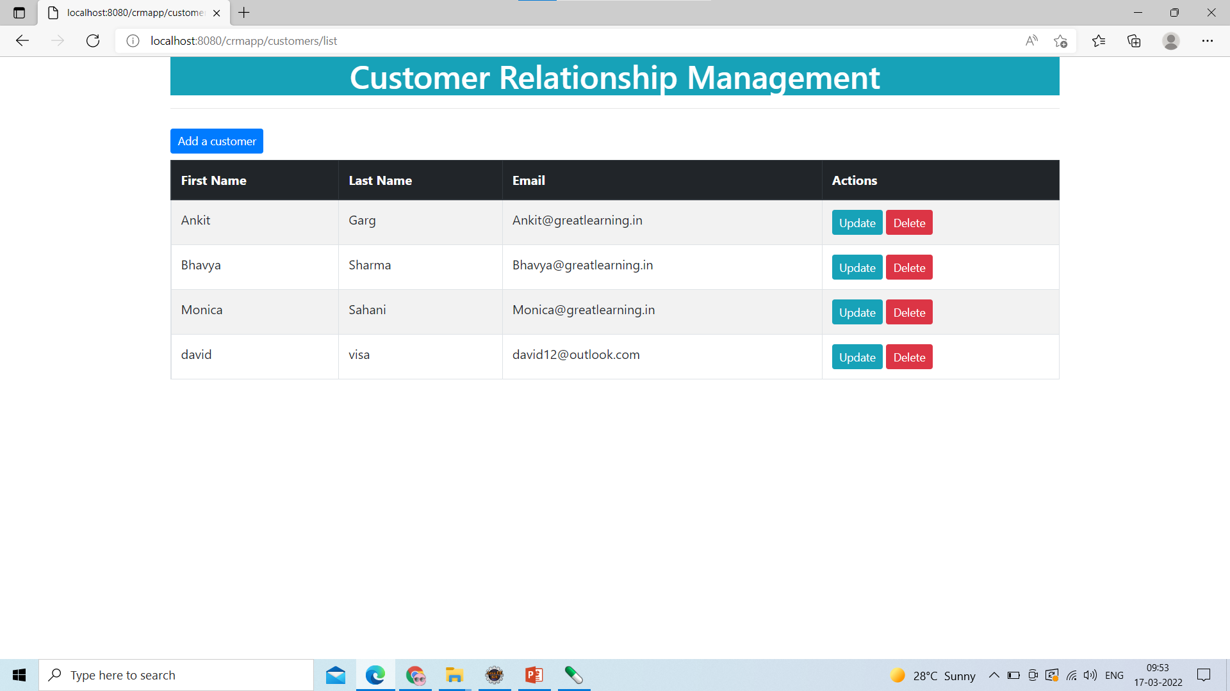
8) Deleted customer Successfully

